Slide 1
Sprint 1 Review
Reading Web News Sources
November 16, 2017
Jon Honda

Slide 2
Sentiment moves market prices
Is it good news? Bad news? (bias)
Are different sources covering different aspects of story?
Are different sources tending toward different biases?
Identify article sentiment
Sprint: Reading Web News Sources
Motivating Idea

Slide 3
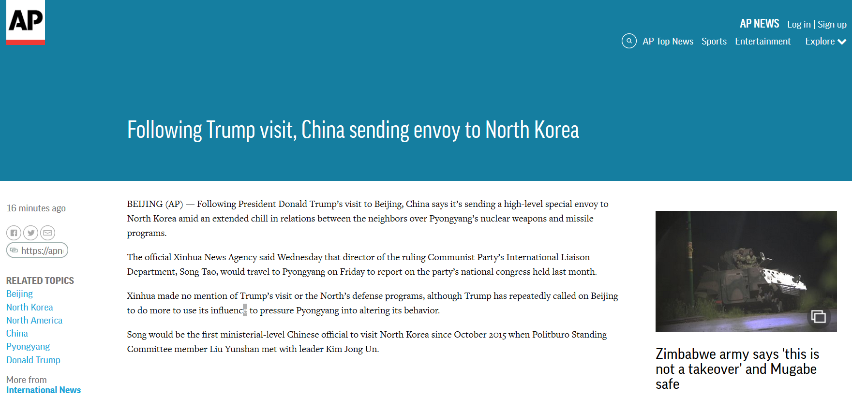
Step 1: How do web sources encode their articles?
Sprint: Reading Web News Sources
Baby Steps…

Slide 4
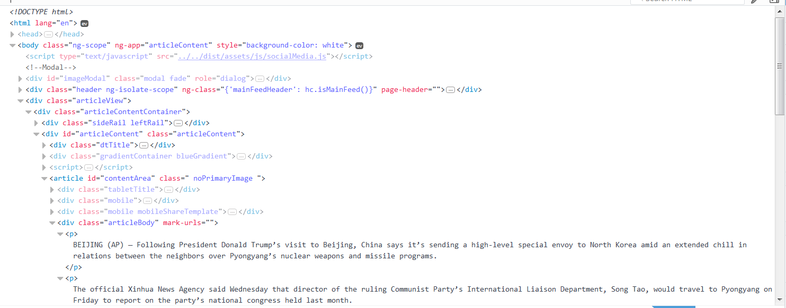
Step 1: How do web sources encode their articles?
Answer: HTML code (a form of XML)
Sprint: Reading Web News Sources
Baby Steps…

Slide 5
Step 1: How do web sources encode their articles?
Answer: HTML code (a form of XML)
…but java script made
Sprint: Reading Web News Sources
Baby Steps…

Slide 6
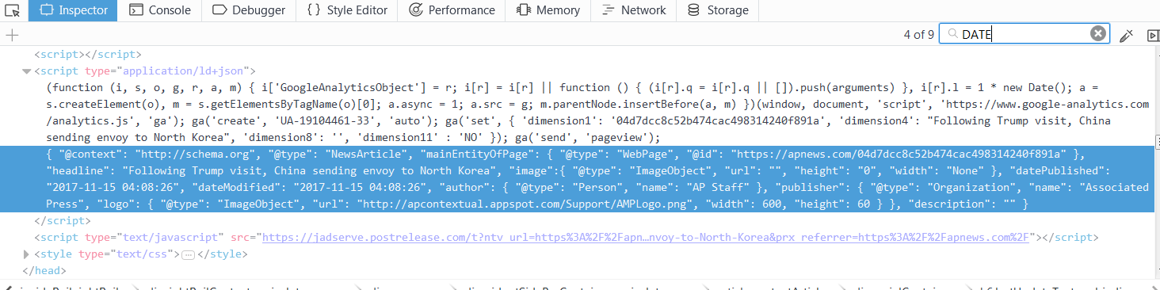
Step 2: Find HTML coding patterns
JSON!
Sprint: Reading Web News Sources
Find Patterns

Slide 7
Step 2: Some JSON News Encodements
Sprint: Reading Web News Sources
Find Patterns

Slide 8
Step 2: Some JSON News Encodements
Sprint: Reading Web News Sources
Find Patterns

Slide 9
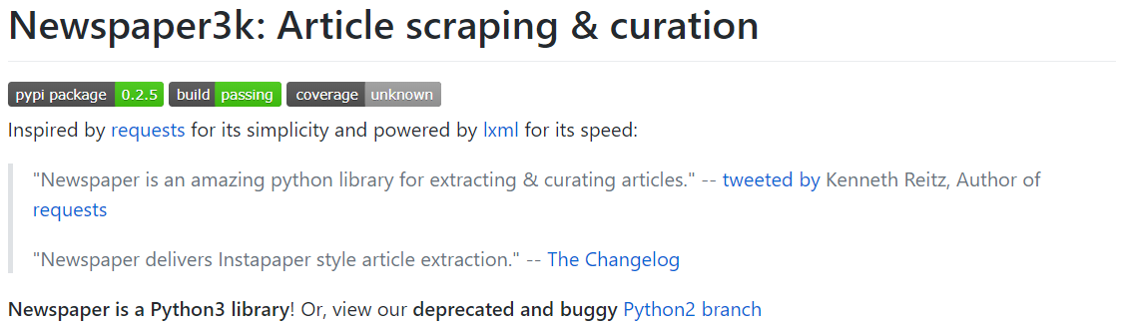
Step 3: Programmatically Extract Data (webscraping)
Sprint: Reading Web News Sources
Extract Data

Slide 10
Step 3: Get web news into Newspaper Library
Code Description
Python Code
Get Article “class” from Library
>>> from newspaper import Article
>>> url = 'https://apnews.com/04d7dcc8c52b474cac498314240f891a/Following-Trump-visit,-China-sending-envoy-to-North-Korea’
>>> myArticle = Article(url)
>>> myArticle.download()
>>> myArticle.parse()
Define news article url
Make instance of Article “class”
Download web article
Extract useful data
Sprint: Reading Web News Sources
Extract Data

Slide 11
Step 3: Get web news into Newspaper Library
Code Description
Python Code
Get Article “class” from Library
>>> from newspaper import Article
>>> url = 'https://apnews.com/04d7dcc8c52b474cac498314240f891a/Following-Trump-visit,-China-sending-envoy-to-North-Korea’
>>> myArticle = Article(url)
>>> myArticle.download()
>>> myArticle.parse()
Define news article url
Make instance of Article “class”
Download web article
Find data
Sprint: Reading Web News Sources
Extract Data

Slide 12
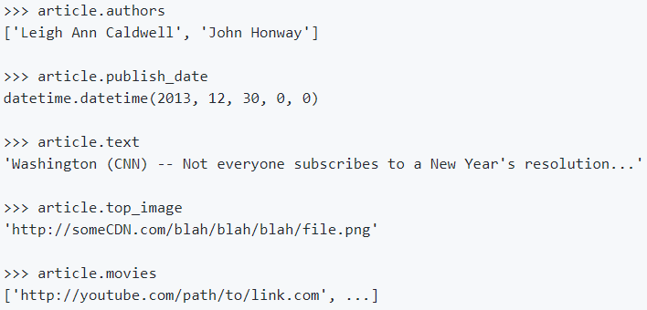
Step 3: Extract Data w/ Newspaper Library
Code Description
Python Code
Get Authors
Get Publish Date
Get Article Text
Get 1st Image
Get Movies
Sprint: Reading Web News Sources
Extract Data

Slide 13
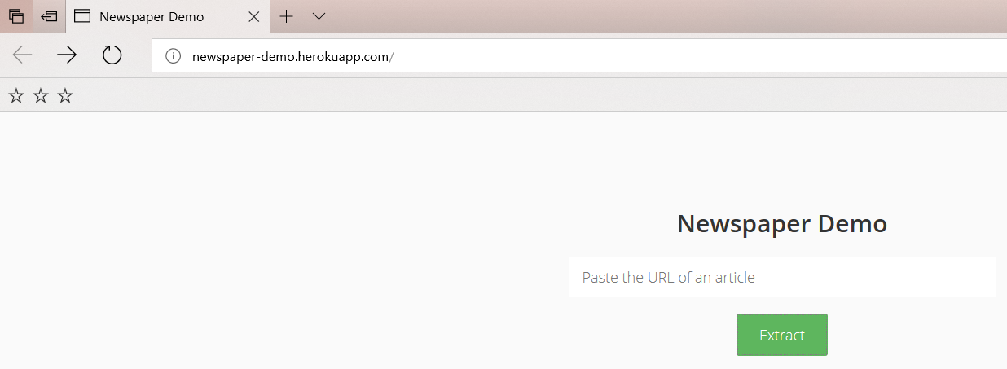
Step 3: Newspaper Library Extracted Data:
Sprint: Reading Web News Sources
Extract Data

Slide 14
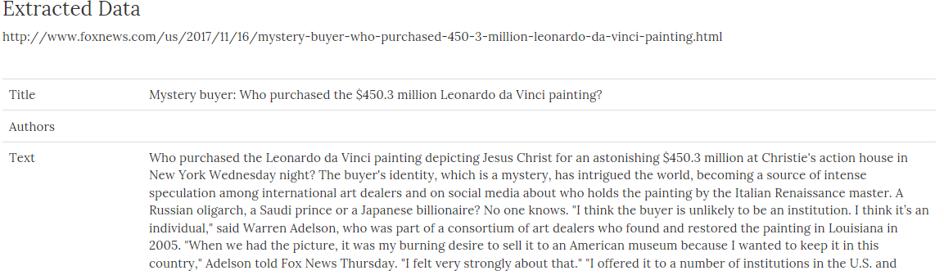
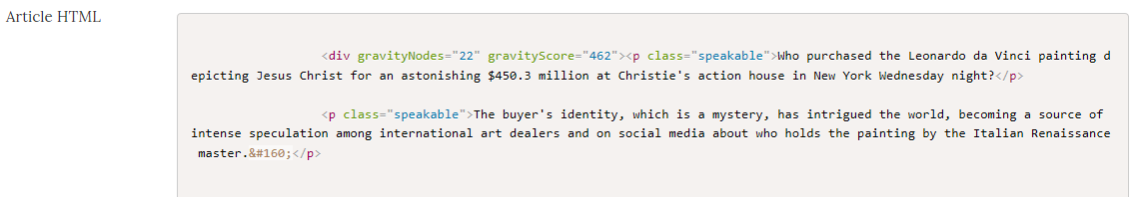
Step 3: Newspaper Library Extracted Data:
Sprint: Reading Web News Sources
Extract Data

Slide 15
Step 3: Newspaper Library – Thin Documentation
Hows’ it work?
What are all the commands?
Any limitations?
Sprint: Reading Web News Sources
Extract Data

Slide 16
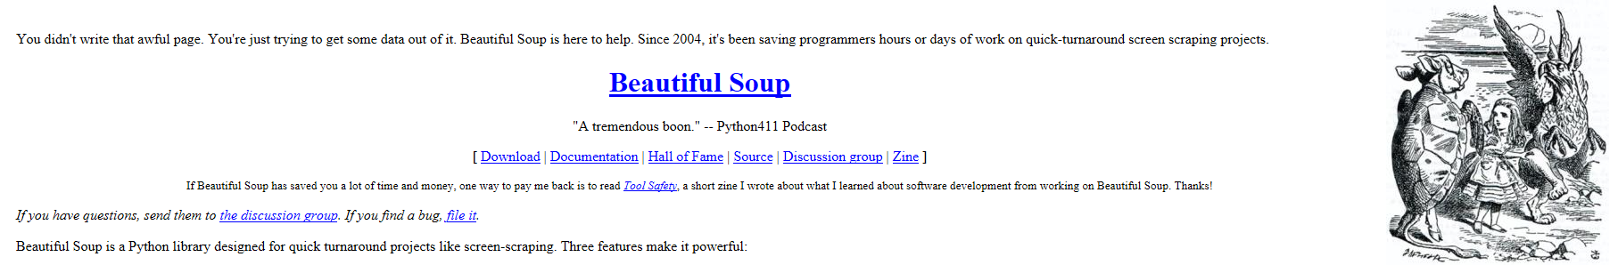
Step 3: No Soup for You…
Hows’ it work?
What are all the commands?
Any limitations?
Solution ?=
Sprint: Reading Web News Sources
Extract Data

Slide 17
Fin
Pau
Done
Sprint: Reading Web News Sources
Sprint: Reading Web News Sources

